Slide 1
Friday Forum, School of Geography and Environmental Studies ‘Journey towards knowledge’
O world of spring and autumn, birth and dying!
The endless cycle of ideas and action,
Endless invention, endless experiment,
Brings knowledge of motion, but not of stillness.
Where is the life we have lost in living?
Where is the wisdom we have lost in knowledge?
Where is the knowledge we have lost in information?

Slide 2
Geography challenges Thinking about a discipline Peter Wilde 9 August 2013

Slide 3

Today we stand in footsteps millennia old.
May we acknowledge the traditional owners
whose cultures and customs have nurtured,
and continue to nurture, this land,
since men and women awoke from the great dream.
We honour the presence of these ancestors who reside in
the imagination of this land and whose irrepressible
spirituality flows through all creation.
Jonathon Hill

Slide 4
My journey towards an understanding of geography

Slide 5
Where my journey has led – so far
Space
Region
Time
Sense of place
Societal and physical processes
Place
Scale
Differential change over time indifferent places
Different outcomes of processes in different places
Different expressions of phenomena in different places
Interactions between places
How the characteristics of place and space influence phenomena, processes and outcomes.
Interaction among phenomena in a place

Slide 6
The 1960s
Classical regional geography
Integrated teaching about human and physical features in space

Slide 7
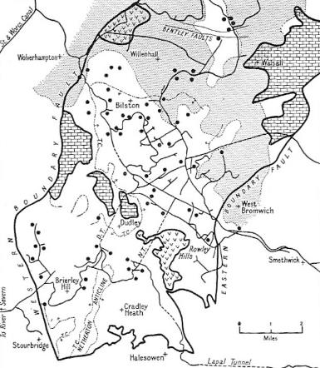
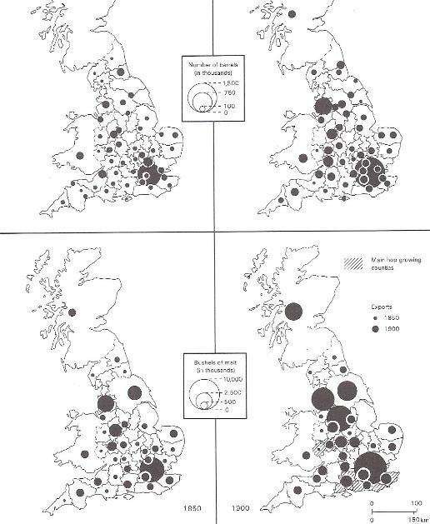
Brewing 1754-1900
West Midlands iron industry around 1850
Iron works – note proximity to canals

Slide 8
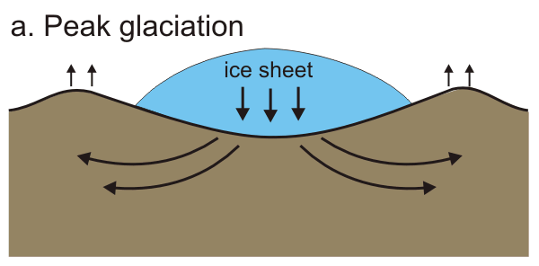
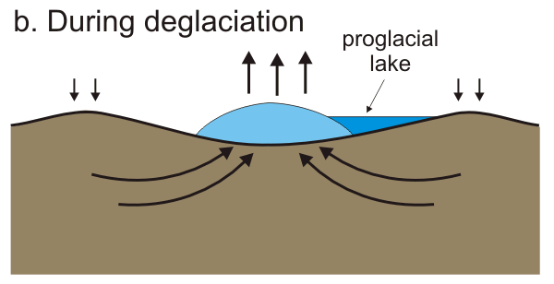
Glacial Isostatic Adjustment (GIA): A (basic) primer
A simple view as
Earth rotational feedbacks
Gravitational feedbacks
-> Global feedbacks
Modelling critically requires
Time-steps of spatial distribution of ice mass
Knowledge of how Earth responds to loading: (3d) Earth structure (notably, lithospheric thickness, lower & upper mantle viscosity)
Poorly understood

Slide 9
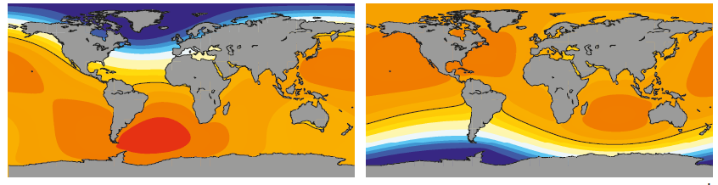
Geography matters! (Courtesy of Matt King)
Greenland mass loss equiv to 1mm/yr global sea level rise
West Antarctic mass loss equiv to 1mm/yr global sea level rise
Pacific islands feel the brunt, regardless
Northern Europe feels less than average due to Greenland melt!

